Slide 1
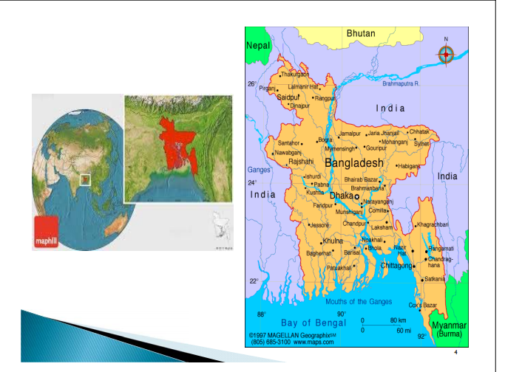
Bangladesh’s Agriculture

Slide 2

How Big is Bangladesh’s Agriculture
Cropping Intensity-191%
Cultivated area is decreasing at 0.43% but no. of small farms increasing at 2% per year
Average farm size is 0.5ha, which is decreasing but no sign of decreasing productivity
High degree of land fragmentation 3.2 plots per farm, average size of plots 0.16 ha.
Non farm household number is increasing at 7% per year
Irrigated land 61%
Homestead agriculture is becoming important.

Slide 3
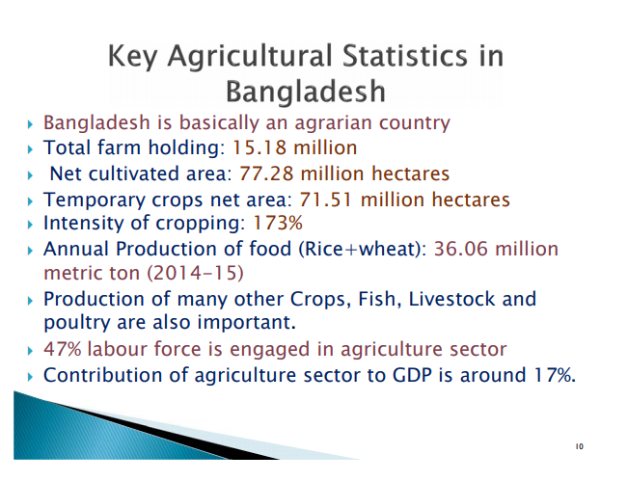

Slide 4
Importance of agriculture
21% GDP
48% labor force
Source of raw materials as backward and forward linkage for agro based industries
Agriculture determines people’s lives and livelihood of this region
People living in rural areas 77%
Export value 12%

Slide 5
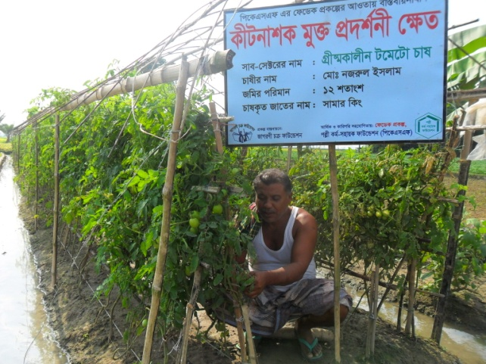

Slide 6
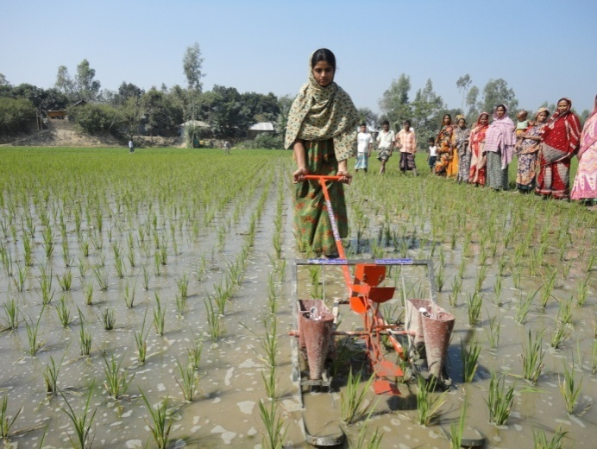
Urea Super Granule (USG)
Production of rice increased by 15-20 %
Decreased urea application by 20-30%

Slide 7
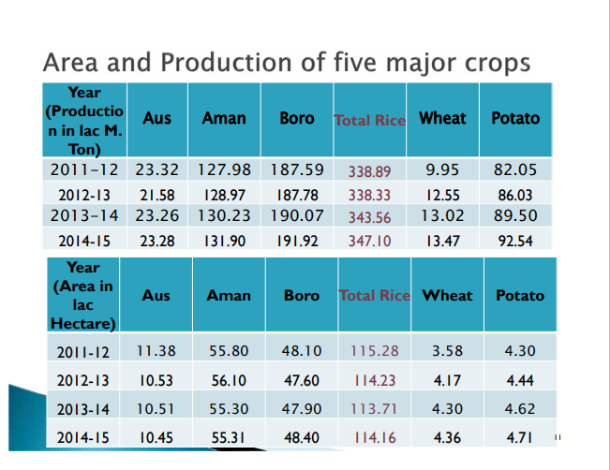

Slide 8
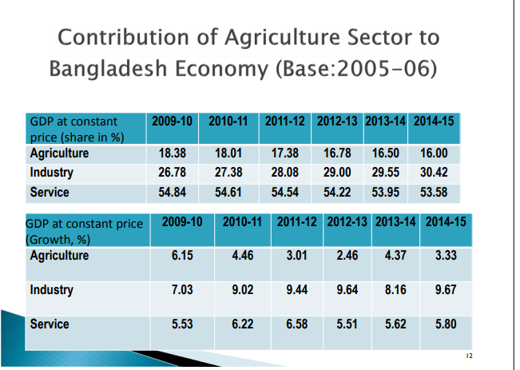

Slide 9
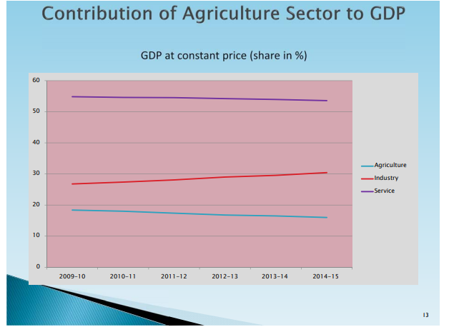

Slide 10
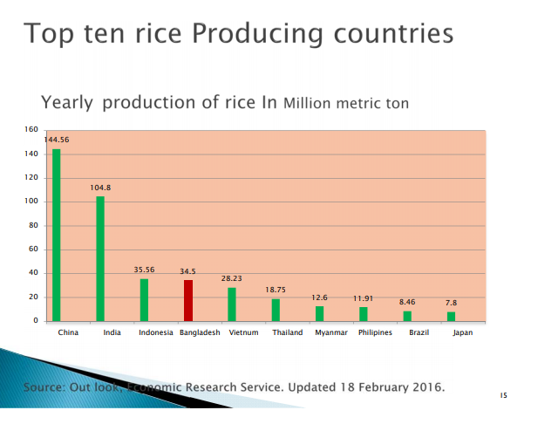

Slide 11
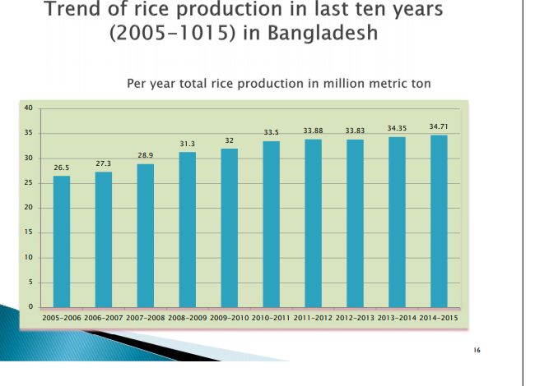

Slide 12
Some challenges
Rapid shrinkage of agricultural land @1% p.a.
Population growth @1.48% p.a.
Climate change and variations
Rapid urbanization growth @12% p.a.
Agricultural research and education (manpower shortage, updating course curriculum)
Technology generation (needs expertise, time and money)
Technology dissemination (needs expertise,
time, logistics support)
Alternate livelihoods/rehabilitation program
Inadequate value addition /food processing

Slide 13
Challenges continued…
Climate change adaptation & mitigation
Developing stress tolerant varieties
Transferring updated information and technologies to the field
Attaining irrigation efficiency
Regaining soil fertility and natural ingredients
Research-extension-farmer-market linkage
Shortage of Agril labour at peak seasons

Slide 14
Challenges
Ensuring Food Security at national, household and individual level
Decline in soil fertility and lose of land and water resources
Non availability of quality seed
Lack of maintenance of soil fertility
Lack of irrigation coverage
Lack of linkage between research extension linkages

Slide 15
Prospects of Agriculture:
Modern technological know-how is available for dissemination
Scope for expanding hybrid technology exists(10%)
Prospects for adoption of advanced technology in agriculture are bright
Potentials for proper utilization of hilly/coastal areas including agro-ecologically disadvantaged regions exist
Export potentials exist for high-value crops
Scope for crop diversification, intensification and value addition to agricultural produces
Agriculture sector has capacity to absorb labor force and to generate income
Scope for reducing yield gaps exists

Slide 16
Thank You

